Slide 1
The Industrial Revolution
AIM: What effect did the
Industrial Revolution have on
the United States?

Slide 2
Terms to Know
Capital – large amounts of money.
Capitalist – person who invests in a business in order to make a profit.
Spinning Jenny – machine that can spin several threads at once.
Urbanization – movement of the population from farms to cities.
Factory System – method of producing goods that brought workers & machinery together in one place.

Slide 3
The Industrial Revolution Begins
Industrial Revolution –a long, slow process that completely changed the way in which goods were produced.
Before the 1800s, most Americans were farmers & most goods were produced by hand.
Progress of the Industrial Revolution
Machines replace hand tools
Steam power replaces human & animal power
Economy shifts towards manufacturing

Slide 4
New Technology
Industrial Revolution started in Britain in the mid 1700s.
Demand for cloth grew leading to new inventions to increase production and speed. In the 1600s cotton cloth imported from India became popular.
British merchants organize cotton industry at home.
British inventors developed new machines that transformed the textile industry.

Slide 5
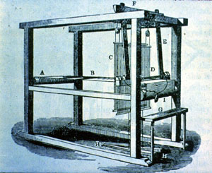
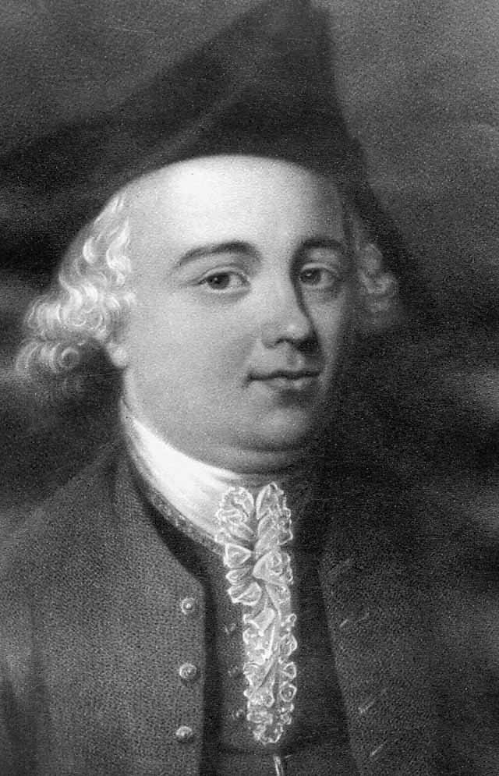
Flying Shuttle & Spinning Jenny
Invented in 1733 by John Kay.
Flying shuttle – invention that enabled weavers to weave faster.
Now weavers were outpacing spinners.

Slide 6
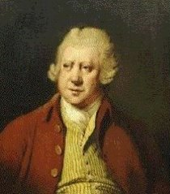
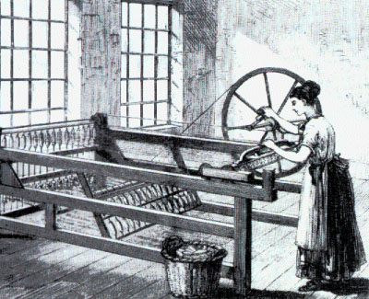
In 1764, James Hargreaves developed the spinning jenny.
Since the Middle Ages, workers had used spinning wheels to make thread; however, a spinning wheel only produced one thread at a time.
The spinning jenny was a machine that could spin several threads at once.
One person could do the job of 50.

Slide 7
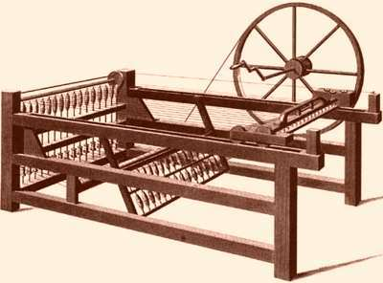
Flying Shuttle
Spinning Jenny
http://videos.howstuffworks.com/discovery/31667-industrial-revelations-spinning-jenny-video.htm
Why do you think these inventions were important?

Slide 8
Factory System
New inventions led to a new system of producing goods.
Before the Industrial Revolution, most spinning & weaving took place at home.
New machines were large & had to be housed in large mills near rivers.
Why do you think water was needed for machines?

Slide 9
New Technology Cost Money
To set up & operate a spinning mill required large amounts of capital (money).
Capitalists supplied money, built factories, and hired workers to run machines.
Factory system established:
Workers & machinery together in one place
Factory workers earned daily or weekly wages
Set hours each work day

Slide 10
Revolution Reaches America
Britain wanted to keep technology a secret. Passed a law forbidding anyone to take machinery plans out of the country.
Samuel Slater, a skilled British textile mechanic, decided to bring plans to America.
He brought plans to Rhode Island textile mill, which became the 1st successful textile mill is the U.S.
Other U.S. plants used plans & became successful.

Slide 11
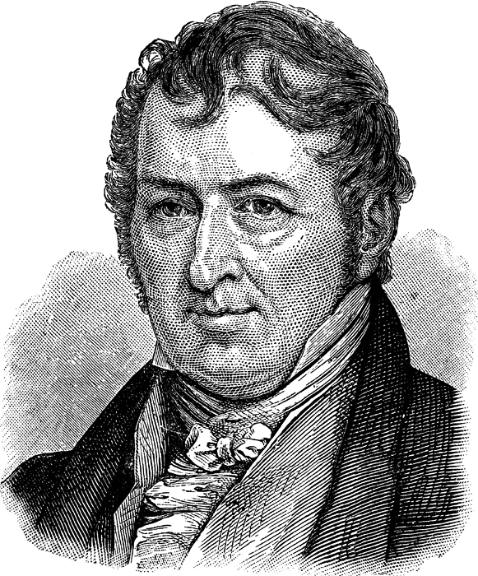
Eli Whitney
Earlier skilled workers made goods by hand.
Since parts were made by hand they were all different.
Whitney introduced interchangeable parts, machine made parts that were identical.
These parts would save time and money.
Small workshops grew into factories.

Slide 12
A Model Factory Town
British blockade from War of 1812 forced Americans to produce more goods for themselves.
Francis Cabot Lowell, a Boston merchant, found a way to improve British textile mills.
In Britain, one factory would spin and one would weave.
Do you think this is efficient?
Lowell builds a mill in Waltham, MA that combines both spinning & weaving under one roof.

Slide 13
Lowell, Massachusetts
After his death, his partners built an entire factory town and named it after him.
1821: Lowell, MA was a village of farm families.
1836: population of more than 10,000 people.
Lowell Girls
Young women from farms hired to work in factories. (Lowell girls)
After a few years of work they returned home to marry.
Most women valued economic freedom.

Slide 14
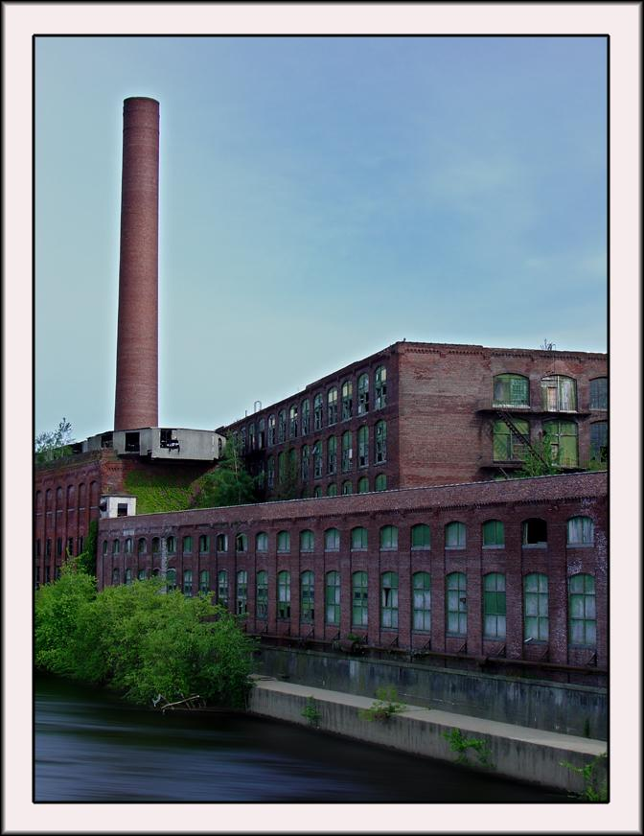
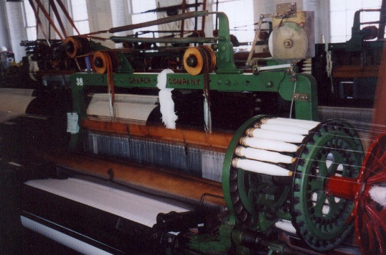
Lowell Mills

Slide 15
Working Conditions
Mill owners hired mostly women & children.
Why do you think this is?
They could pay them half of what men made.
Boys & girls as young as 7 worked in factories.
Small children could squeeze around large machines.
Normal work day was 12 hours long and was a 6 day work week.

Slide 16
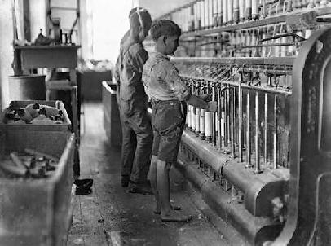
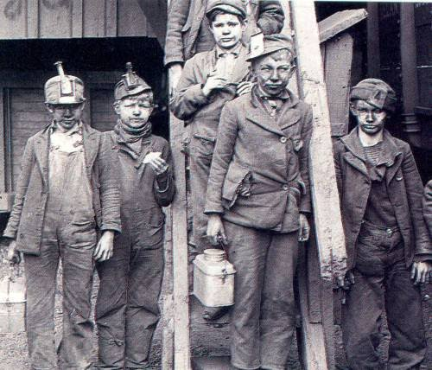
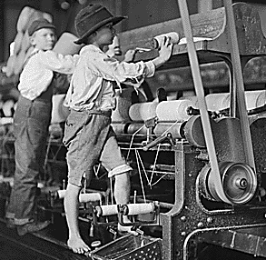
Child Labor

Slide 17
Changes in Home Life
Rich Families
Husband supported the family
Wives stayed home
A wife at home was a sign of success
Poor Families
Husbands worked
Wives worked
Children worked

Slide 18
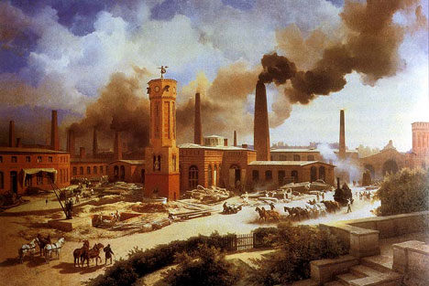
Growing Cities
New cities sprang up around factories.
Urbanization of cities began.
Growing cities had many problems:
Pollution
Disease
Overpopulation
Cities had attractions:
Shopping in fine stores
Theaters
Museums

